Slide 1




Synaptic Theory of Working Memory
AIBC2021
Aohua Cheng
Tsinghua University

Slide 2

Self-Introduction
Aohua Cheng
Lab : Medicine & Medical Robot Research Center, Sunpei/Tyanyang Lab
Research background :
Medical Robot, Computational neuromorphology
Interest:
Consciousness, Biophysics, ANN
Swimming, Tennis

Slide 3
Project background and the scientific question
• Working Memory: Temporary information for processing purposes, playing a crucial role in cognitive tasks. Delayed-response paradigm
• Background Survey: emerge from intrinsic cell properties or as persistent reverberations in selective neural populations coding for different memories
• What saves working memory?
We therefore propose that an item is maintained in the WM state by short-term synaptic facilitation mediated by increased residual calcium levels at the presynaptic terminals of the neurons that code for this item
Synapse Theory of Working Memory G Mongillo, O Barak, M Tsodyks - Science, 2008

Slide 4

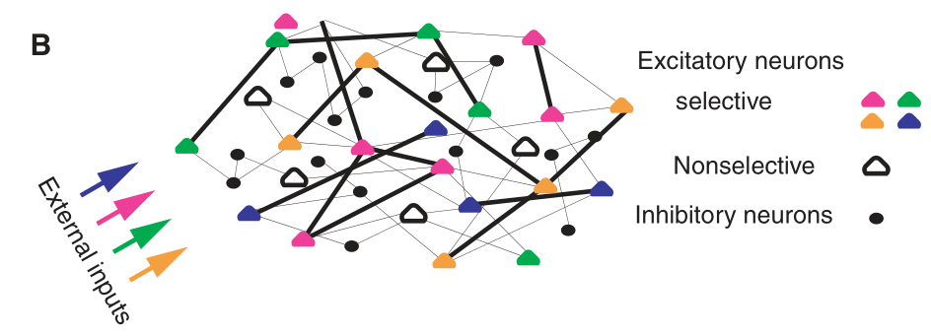

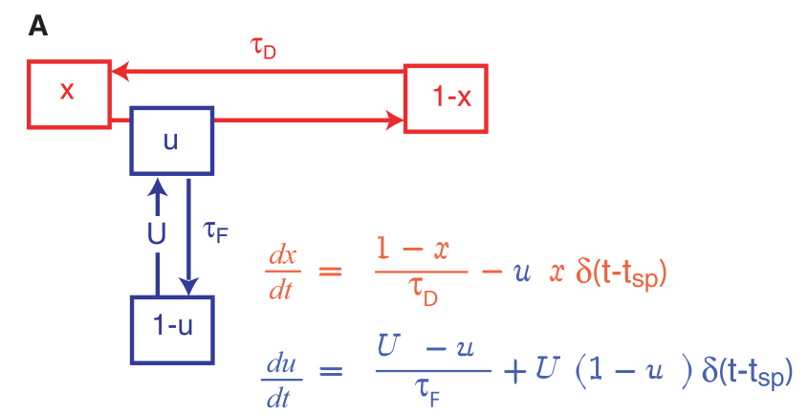
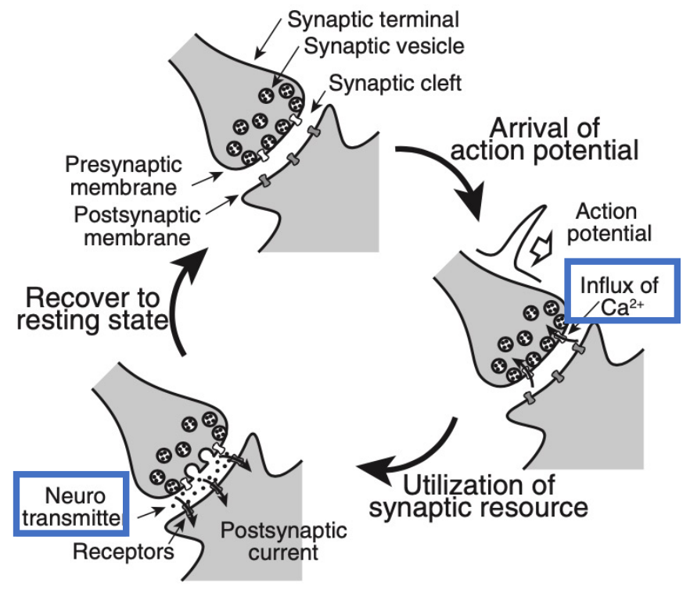


Method
Neuron : LIF model
Network: specific connectivity
Synapse: Short Term Potential

Slide 5
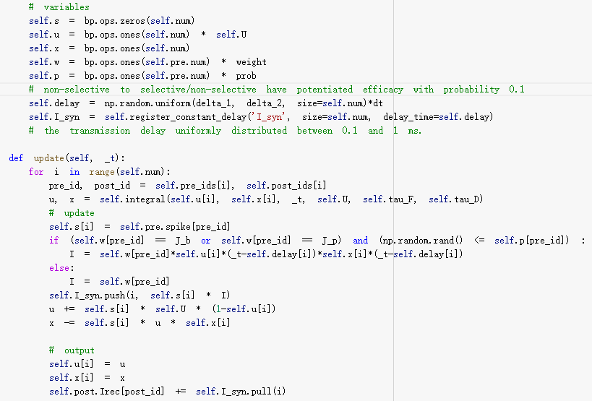
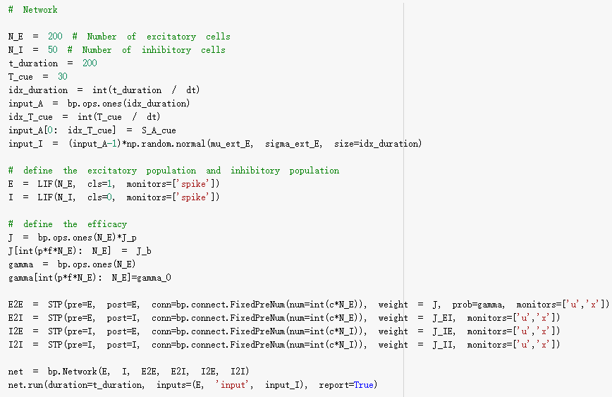
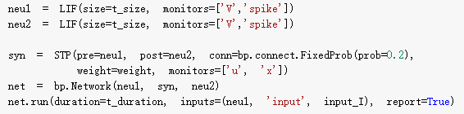
Method
STP class
Network class
One-item coding

Slide 6
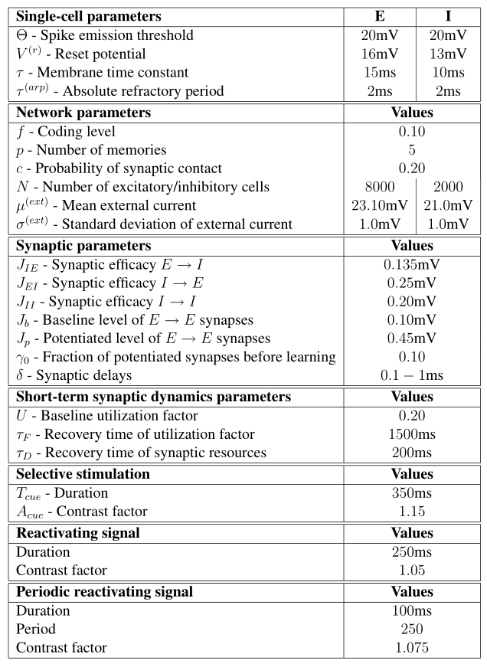
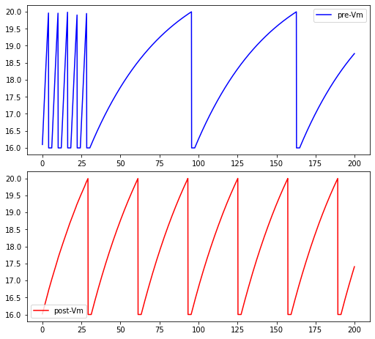
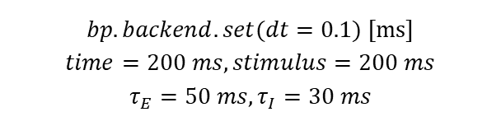
Results
Parameters setting
2-neuron 1-stimulus simulation
$$bp.backend.set(dt=0.1\text{) [}\text{ms}\text{]}$$
$$time=200 ms, stimulus=200 ms$$
$$τ_{E}=50 ms, τ_{I}=30 ms$$

Slide 7
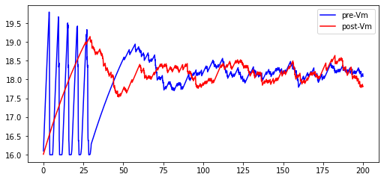
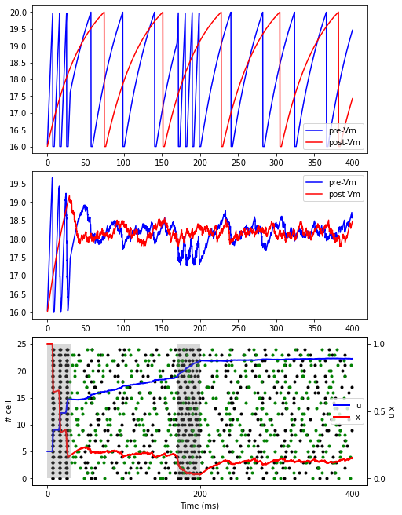
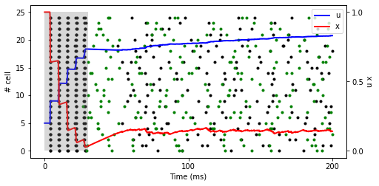
Results
2-neuron stimulation
2-neuron 2-stimulus simulation

Slide 8
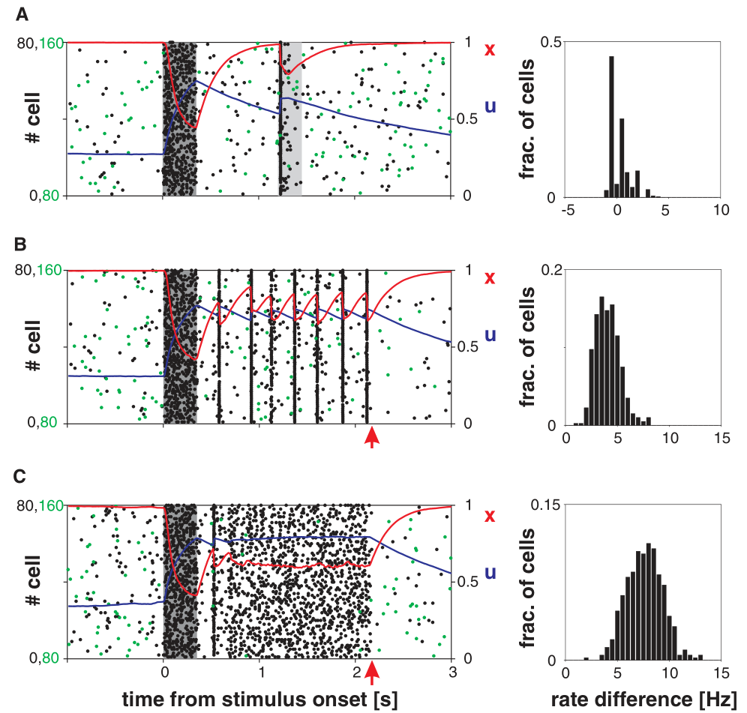
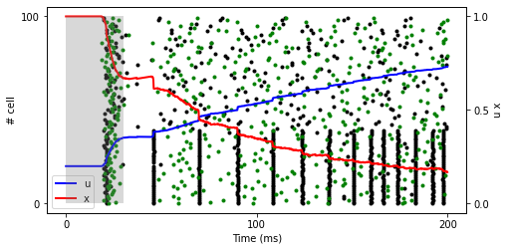
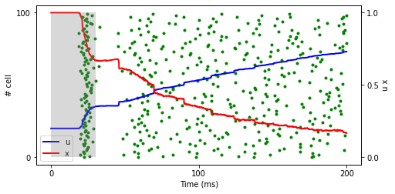

Results
$$N_{E}=200, N_{I}=50$$
$$τ_{E}=50 ms, τ_{I}=30 ms$$
One-item Network stimulation

Slide 9
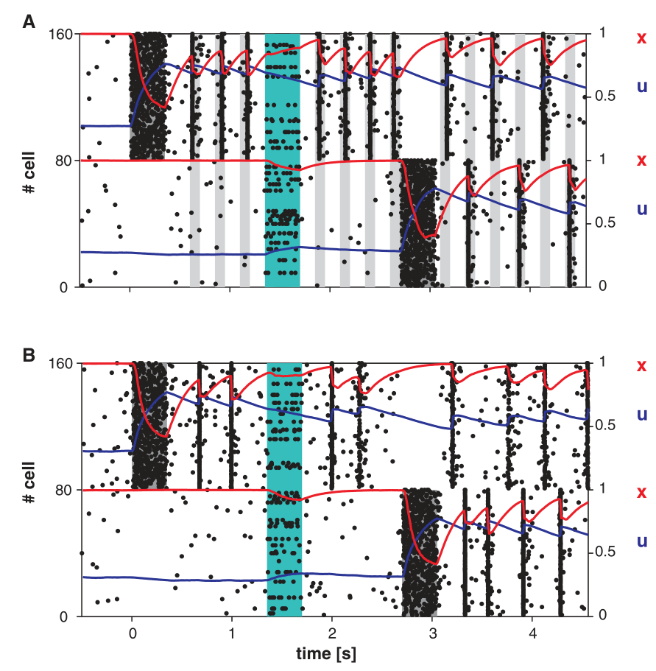
Results
Two-item Network stimulation
Robustness to noise and two-item memory. The first item is loaded into memory at t = 0 (dark shading). The second item is loaded into memory at t = 2.7 s. Teal shading indicates a random nonspecific input to 15% of the excitatory neurons. (A) Periodic sequence of nonspecific external inputs is used to refresh the memory (gray shading). (B) Persistent PSs. Dots, rasters of 10% of the first (0 to 79) and second (80 to 159) populations' neurons; red and blue curves, same
as in Fig. 2.

Slide 10
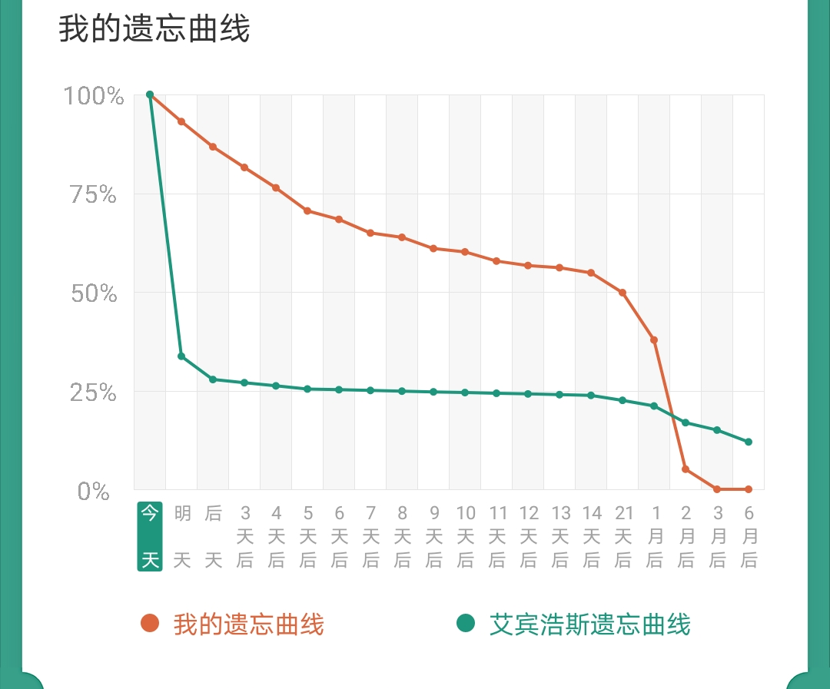
Discussion
• More explanation about the simulation, Bifurcation analysis
• Memory recall : The Ebbinghaus Forgetting Curve
• Neuromorphology by brainpy

Slide 11
Acknowledgment
Thank Zilong Ji, XiaoLiu, Chaoming Wang’s help for tutorials and project.
Thank Professors for exciting lectures to broaden our horizon of CN and AI.
Thank Prof. Si Wu, Jun Zhang .etc for organizing such a wonderful summer school.
Thank peers for discussing and having a good time in CSHA.

Slide 12
Q & A ～5 mins
AI and Brain Computation
August 9 - August 22, 2021

Slide 13
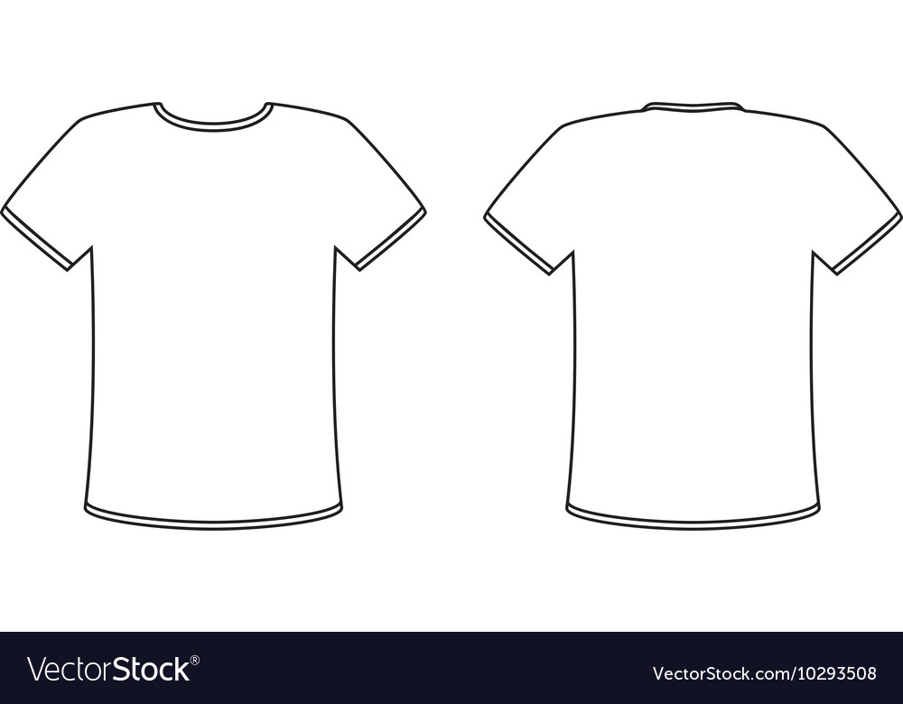
Your T-shirt Design
Memory for our AIBC2021～
Don‘t Quit！
Tips：
1，可以体现AI和Brain Computing的交叉
2，可以体现2021的元素（今年是我们第一届summer school，是元年）
3，可以体现online课程的特殊性
4，可以体现你对AIBC2021的感受
5，...

